Slide 1
CSE101-Lec#6-Part-2
Control Structures[Repetition structures/ or Looping statements/ or Iterative statements]

Slide 2
In summary, the switch statement is typically used for testing a single variable against multiple possible values, and is often more efficient than a long chain of if-else if statements. The if-else if statement is more suited for testing multiple conditions, and offers greater control over the flow of the program.

Slide 3
1000 if elseif then 1000 comparison.
But in case of switch if 1000 cases then only one case is true and execution time only for one correct case or default one.

Slide 4
Outline
Repetition structure/Control Loop Statements
for statement
while statement
do-while statement

Slide 5



Repetition(Going to School)
Day = Monday to Saturday

Slide 6
Looping (repetition)
What if we want to display hello 500 times?
Should we write 500 printf statements or equivalent ?
Obviously not.
It means that we need some programming facility to repeat certain works.
Such facility is available in form of looping statements.

Slide 7
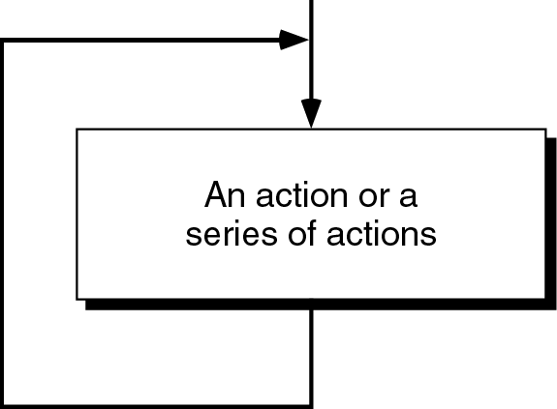
Loop
The main idea of a loop is to repeat an action or a series of actions.
The concept of a loop without condition

Slide 8
But, when to stop looping?
In the following flowchart, the action is executed over and over again. It never stops – This is called an infinite loop
Solution – put a condition to tell the loop either continue looping or stop.

Slide 9
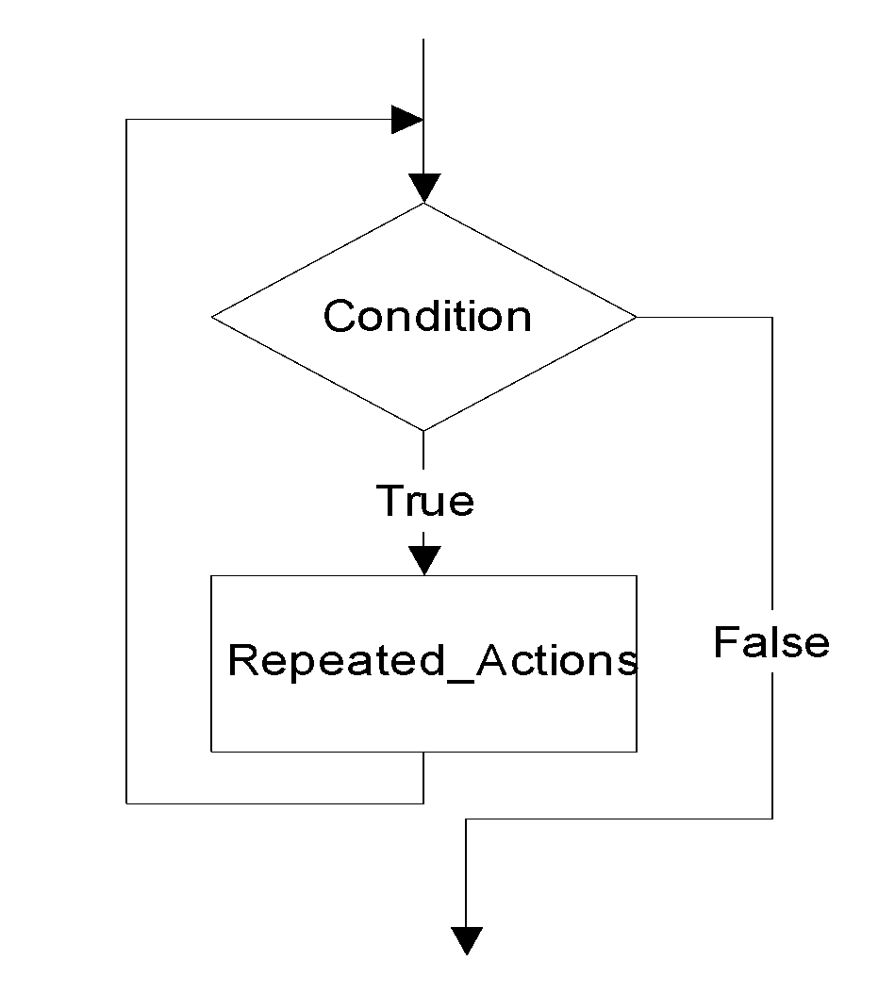
Loop
A loop has two parts – body and condition
Body – a statement or a block of statements that will be repeated.
Condition – is used to control the iteration – either to continue or stop iterating.

Slide 10
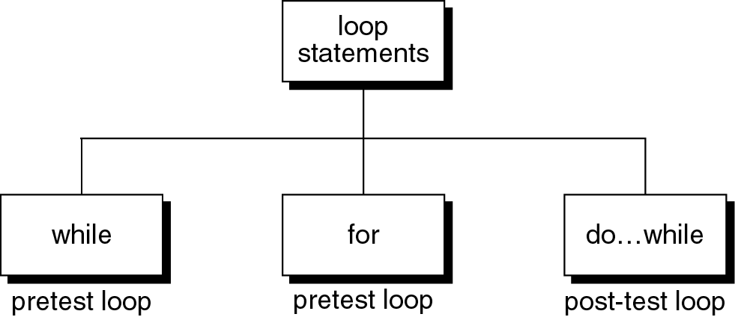
Loop statements
C provides three loop statements:

Slide 11
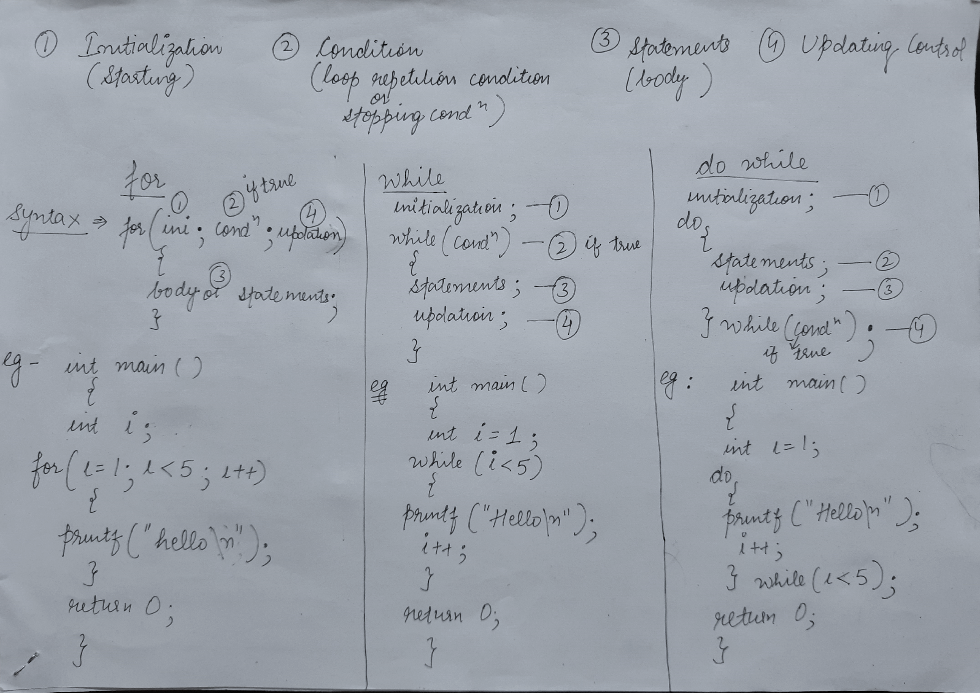
Loop statements

Slide 12
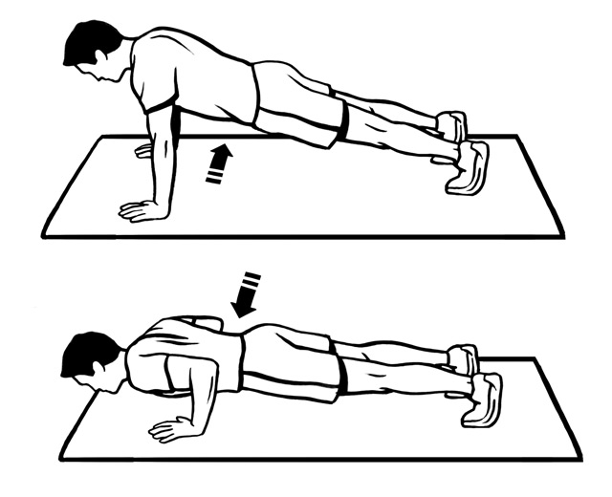
The “while” Statement in C
The syntax of while statement in C:
while (loop repetition condition){
statement;
updating control;
}
Syntax
While fatigue level is not reached

Slide 13
while statement
while(loop repetition condition)
{
Statements;
}
Loop repetition condition is the condition which controls the loop.
The statement is repeated as long as the loop repetition condition is true.
A loop is called an infinite loop if the loop repetition condition is always true.
while loop is known as entry controlled loop, as condition is checked at the beginning/ or entry point

Slide 14
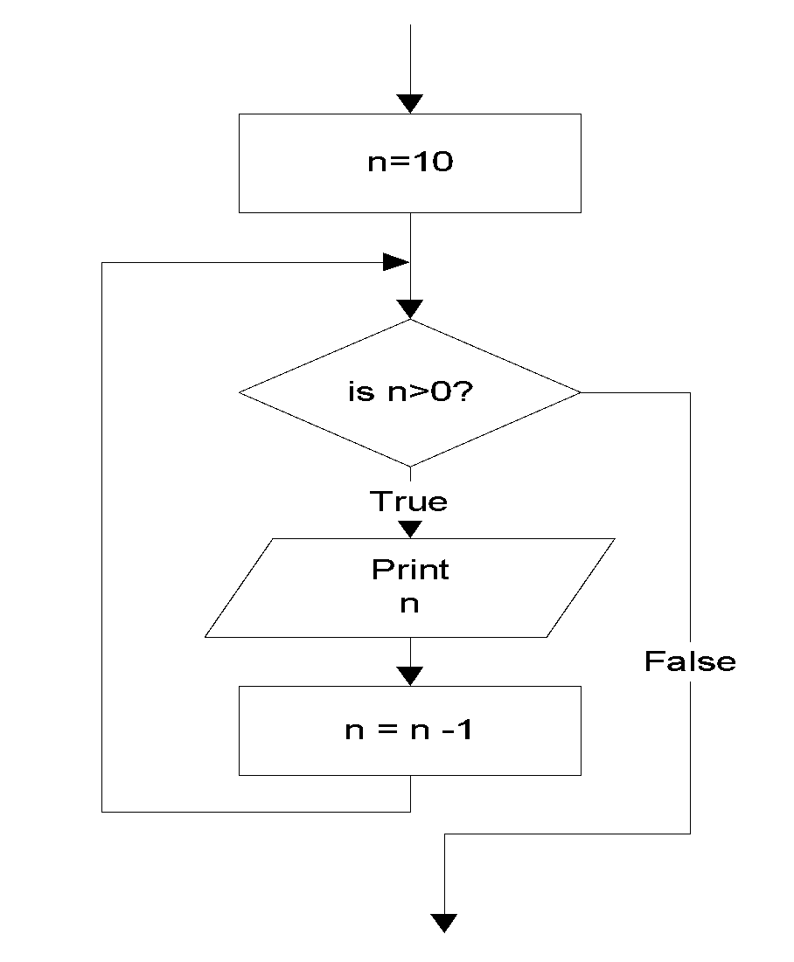
while statement
Example: This while statement prints numbers 10 down to 1
#include<stdio.h>
int main()
{
int n=10;
while (n>0){
printf(“%d ”, n);
n=n-1;
}
return 0;
}
10 9 8 7 6 5 4 3 2 1
Do TEN push ups imposes a count condition

Slide 15
Q1
How many times i value is checked in the following C code?
#include <stdio.h>
int main()
{
int i = 0;
while (i < 3)
i++;
printf("In while loop\n");
}
A. 2
B. 3
C. 4
D. 1

Slide 16
Q2
What will be the output of the following C code?
#include <stdio.h>
int main()
{
int i = 0;
while (++i)
{
printf("H");
}
return 0;
}
A. H
B. H is printed infinite times
C. Compile time error
D. Nothing will be printed

Slide 17
The for Statement in C
The syntax of for statement in C:
The initialization-expression set the initial value of the loop control variable.
The loop-repetition-condition test the value of the loop control variable.
The update-expression update the loop control variable.
It is also known as entry controlled loop as condition is checked first and then loop body executes
for (initialization-expression;
loop-repetition-condition;
update-expression){
statement;
}
Syntax

Slide 18
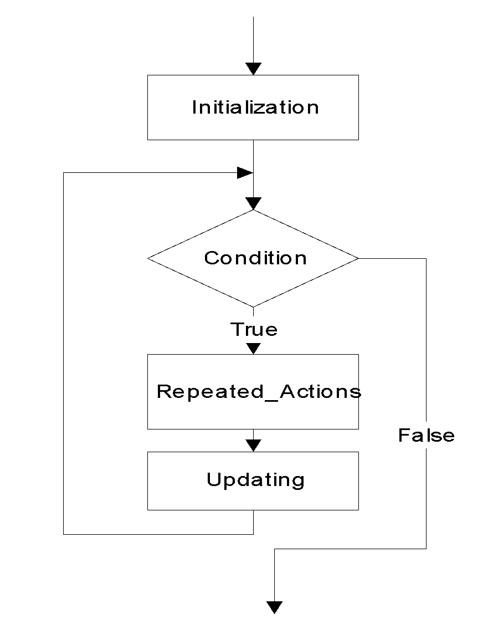
for statement
for (Initialization; Condition; Updating)
{
Repeated_Actions;
}

Slide 19

for statement
Example: This for statement prints numbers 10 down to 1
#include<stdio.h>
int main()
{
int n;
for (n=10; n>0; n=n-1){
printf(“%d ”, n);
}
return 0;
}
10 9 8 7 6 5 4 3 2 1
Do TEN push ups = for count=1; count<=10; count++

Slide 20
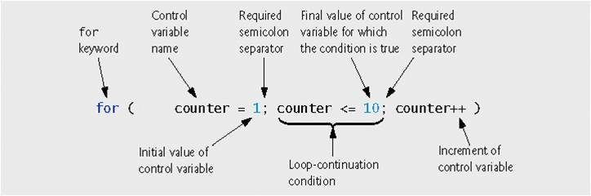

Slide 21
Program to find sum of first n numbers
#include<stdio.h>
int main()
{
int n,i,sum=0;
printf("enter the value");
scanf("%d",&n);
for(i=1;i<=n;i++)
{
sum=sum+i;
}
printf("the sum=%d",sum);
return 0;
}

Slide 22
Program to find sum of digits of a number
#include<stdio.h>
int main()
{
int no,sum=0,n;
printf("enter the no");
scanf("%d",&no);
while(no!=0)
{
n=no%10;
sum=sum+n;
no=no/10;
}
printf("the sum of digits=%d",sum);
}

Slide 23
Q1
#include <stdio.h>
int main()
{
int i;
for (i = 1; i != 10; i += 2)
printf("Hello");
return 0;
}
A. Hello will be displayed 5 times
B. Hello will be displayed 4 times
C. Hello will be displayed infinite no. of times
D. Hello will be displayed 6 times

Slide 24
Q2
What will be the output of following code
#include<stdio.h>
int main()
{
int i;
for(i=1;i<10;i++);
printf("%d",i);
return 0;
}
Numbers from 1 to 9 will be printed
10
9
Infinite loop

Slide 25
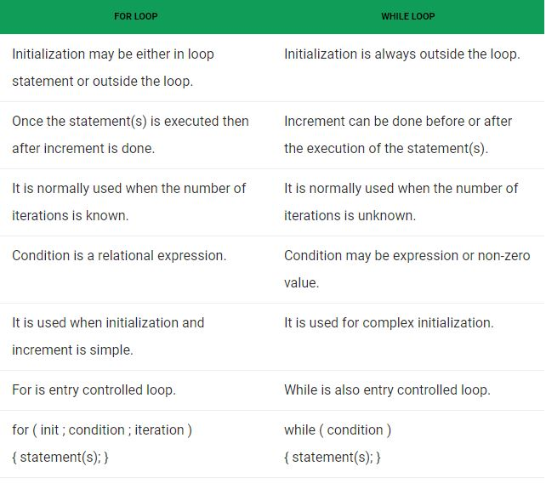
for vs while loop

Slide 26
Nested Loops
Nested loops consist of an outer loop with one or more inner loops.
Eg:
for (i=1;i<=100;i++){
for(j=1;j<=50;j++){
…
}
}
The above loop will run for 100*50 iterations.
Outer loop
Inner loop

Slide 27
Program to print tables up to a given number.
#include<stdio.h>
int main()
{
int i,j,k ;
printf(“Enter a number:”);
scanf(“%d”, &k);
printf(“the tables from 1 to %d: \n”,k);
for(i=1; i<k; i++){
for(j=1; j<=10; j++){
printf(“%d ”,i*j);
} //end inner for loop
printf(“\n”);
} //end outer for loop
return 0;
} //end main
Enter a number
4
The tables from 1 to 4
1 2 3 4 5 6 7 8 9 10
2 4 6 8 10 12 14 16 18 20
3 6 9 12 15 18 21 24 27 30
4 8 12 16 20 24 28 32 36 40
Notes:
K =100
Number: 1 cube: 1
Number:2 cube: 8
Number: 3 cube: 27
Number: 4 cube: 64

Slide 28
Program to display a pattern.
#include<stdio.h>
int main()
{
int i,j;
printf(“Displaying right angled triangle for 5 rows”);
for(i=1 ; i<=5 ; i++) {
for(j=1 ; j<=i ; j++)
printf(“* ”);
printf(“\n”);
}
return 0;
}
Displaying right angled triangle for 5 rows
*
* *
* * *
* * * *
* * * * *

Slide 29
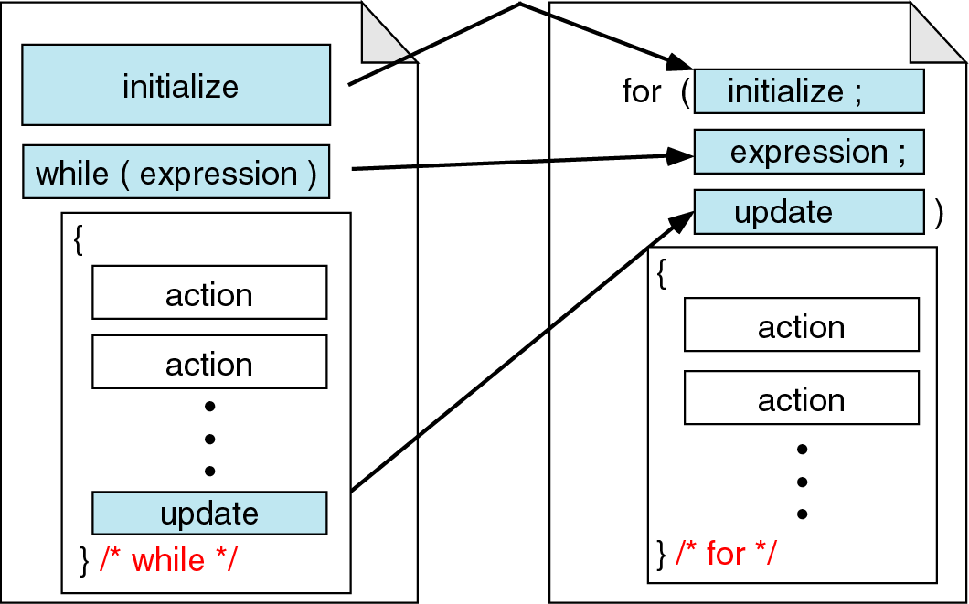
While vs. for statements
Comparing for and while loops

Slide 30
The do-while Statement in C
The syntax of do-while statement in C:
The statement executed at least one time(even if the condition is false)
For second time, If the condition is true, then the statement is repeated else the loop is exited.
Also known as exit-controlled loop, as loop body executes first and then the condition is checked
do
{ statement;
} while (condition);
Syntax

Slide 31
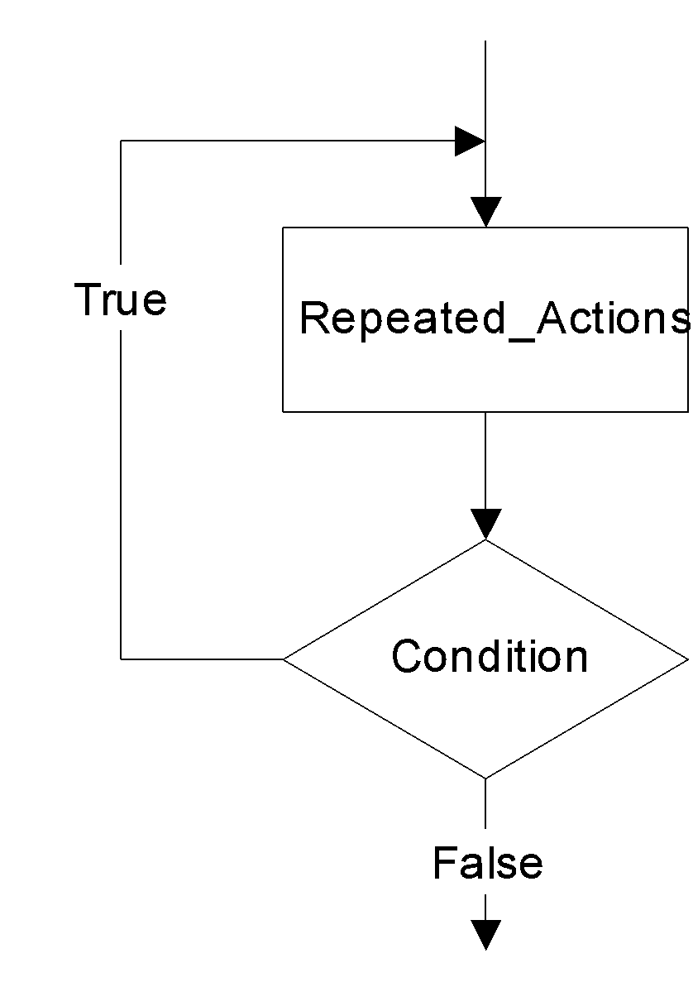
do…while statement
do
{
Repeated_Actions;
} while (Condition);

Slide 32
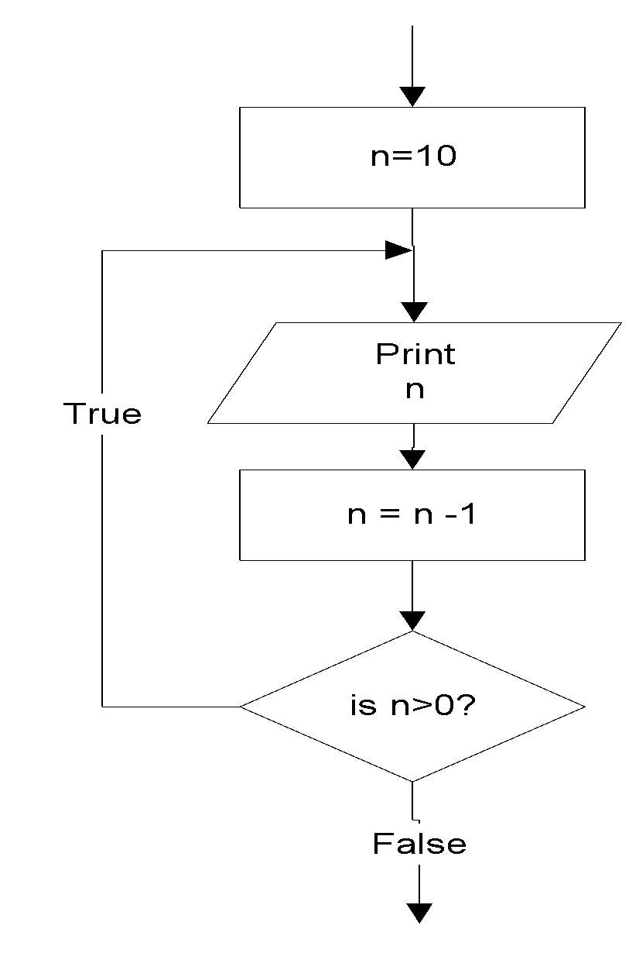
do…while statement
Example: this do…while statement prints numbers 10 down to 1
#include<stdio.h>
int main()
{
int n=10;
do{
printf(“%d ”, n);
n=n-1;
}while (n>0);
}
10 9 8 7 6 5 4 3 2 1

Slide 33
Difference between while and do..while
while loop | do..while loop
1. Condition is specified at the top | 1. Condition is mentioned at the bottom
2. Body statements are executed when the condition is satisfied | 2. Body statements are executed at least once even if the expression value evaluates to false
3. It is an entry controlled loop | 3. It is an exit controlled loop
4.Syntax: while (condition) statement; | 4.Syntax: do { statements; } while (condition);

Slide 34
Q1
What will be the output of the following C code?
#include <stdio.h>
int main()
{
do
printf("In while loop ");
while (0);
printf("After loop\n");
return 0;
}
A. In while loop
B. In while loop
After loop
C. After loop
D. Infinite loop

Slide 35
Q2
What will be the output of the following C code?
#include <stdio.h>
int main()
{
int i = 0;
do {
i++;
printf("In while loop\n");
} while (i < 3);
return 0;
}
A. In while loop
In while loop
In while loop
B. In while loop
In while loop
C. Nothing will be displayed
D. Compile time error

